Slide 1
Privacy Issues Associated with Popular Mobile Applications
Dr. Darren Hayes & Dr. Francesco Cappa
R&D Management Conference
Milan 2018
1. Introduction
2. Background
3. Method
4. Results
5. Conclusions

Slide 2
Mobile apps
1. Introduction
2. Background
3. Method
4. Results
5. Conclusions
2017 → 2.1m iOS apps on Apple’s App Store & 3.6m apps on Google Play
Varying degrees of security & privacy
Organizations should understand mobile apps used by employees
Organizational risk

Slide 3
Mobile apps
1. Introduction
2. Background
3. Method
4. Results
5. Conclusions
Personal & business-owned mobile devices
Monitor apps: leak personal data about employees
Data exfiltration
Malware

Slide 4
Research Question
1. Introduction
2. Background
3. Method
4. Results
5. Conclusions
What are the privacy issues associated with popular mobile applications?

Slide 5
Background
1. Introduction
2. Background
3. Method
4. Results
5. Conclusions
Concerns:
Uber tracks user location → contradicts privacy policies
Apps can be used by government agencies to track/profile individuals
Malware

Slide 6
Background
1. Introduction
2. Background
3. Method
4. Results
5. Conclusions
Research Contribution:
Analysis of privacy issues → highlights the potentially unethical behavior

Slide 7
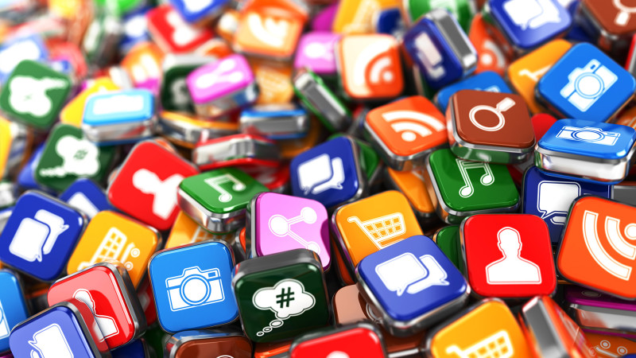
Research design
1. Introduction
2. Background
3. Method
4. Results
5. Conclusions
Static & dynamic analysis
Data collected without user’s consent
Threats to organizational security
Tinder
WhosHere
Instagram
Seamless
Bumble
Spotify

Slide 8
Static analysis
1. Introduction
2. Background
3. Method
4. Results
5. Conclusions
Reverse-engineering app code
Analysis of app SQLite database
App permissions
Identify permissions that violated app developer’s privacy policy

Slide 9
Dynamic analysis
1. Introduction
2. Background
3. Method
4. Results
5. Conclusions
Behaviour of mobile app
Network connections
Server connections associated with distribution of malware
State-sponsored theft of IP

Slide 10
Results
1. Introduction
2. Background
3. Method
4. Results
5. Conclusions
Connects to user’s music playlist from Spotify
Deep-linking
Social media account data captured

Slide 11
Results
1. Introduction
2. Background
3. Method
4. Results
5. Conclusions
Collects geolocation information
Data stored in plaintext (unencrypted)

Slide 12
Results
1. Introduction
2. Background
3. Method
4. Results
5. Conclusions
User’s activity is logged in Facebook account
Exchanges of personal information between apps
No mention in privacy policy statement

Slide 13
Results
1. Introduction
2. Background
3. Method
4. Results
5. Conclusions
Connects with Facebook app
Without the user consent and knowledge
Amazon & Yahoo! servers not disclosed in privacy policies

Slide 14
Results
1. Introduction
2. Backgrounf
3. Method
4. Results
5. Conclusions
SQLite database → unencrypted
Links to Facebook profiles, demonstrating how Facebook
No user consent

Slide 15
Results
1. Introduction
2. Background
3. Method
4. Results
5. Conclusions
App connects to Facebook & Microsoft servers
SQLite database: names, addresses, interests, locations & photos,
Data is unencrypted

Slide 16
Conclusions
1. Introduction
2. Background
3. Method
4. Results
5. Conclusions
Privacy issues with mobile apps
Deep linking
Organizational risk from mobile apps
Organizations should consider static & dynamic app analysis

Slide 17
Thank you!
1. Introduction
2. Background
3. Method
4. Results
5. Conclusions
Questions?
Darren Hayes
dhayes@pace.edu

